Slide 1
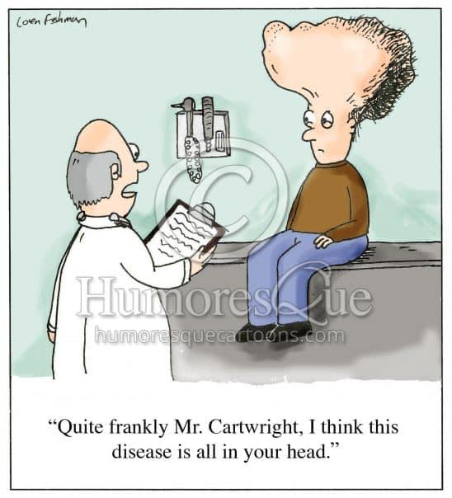
Date: | Human Biology Year 12 ATAR
Do Now Complete the past exam question given, under test conditions (not for actual marks) Lesson Agenda 1: Do Now 2: Diseases of the Nervous System 3: Work on Review Worksheet Nervous System Diseases 4: Lesson summary and wind-up Suggested Study Compulsory: Complete review worksheet, mark and correct using answer key on Connect. Read through today’s notes and textbook section Write out the steps involved in transmission across the synapse. NEXT LESSON Past Exam Question Diseases of the Nervous System | Learning Aims: Describe the cause and disease progression of Huntington’s Disease Describe how gene therapy works and why it may be useful in future to treat Huntington’s Disease Describe the disease progression and symptoms of Parkinson’s Disease Describe the disease progression and symptoms of Alzheimer’s disease Define cell replacement therapy Discuss how cell replacement therapy could be used to treat diseases such as Alzheimer’s and Parkinson’s in future.
 | Key Vocabulary Substantia nigra Amyloid Tau tangles Gene therapy Cell replacement therapy

Slide 2

Diseases of the Nervous System
Ch 4 Human Perspectives –The Nervous System is highly organised
Ch8 Human Perspectives – Technology is used to treat diseases

Slide 3
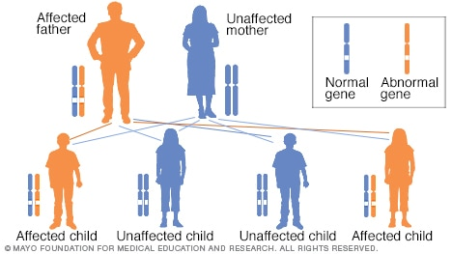
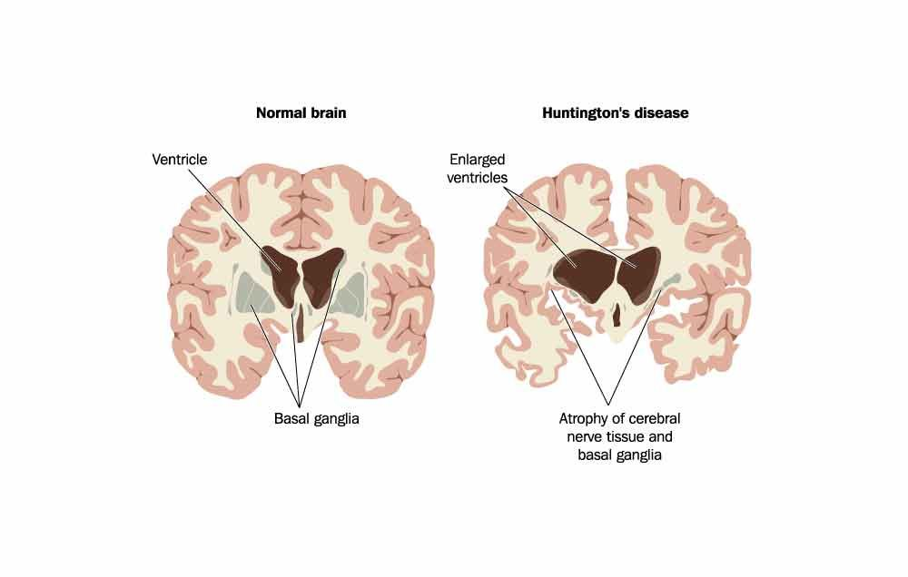
Huntington’s Disease
A single gene disorder – dominant inheritance.
Abnormal gene:
Codes for a mutated protein (huntingtin)
Protein damages nerve cells in the brain
Large
Symptoms start after age 40 and are progressive:
Physical, mental and emotional changes
Progressive dementia, limb flailing.
Currently incurable, fatal.
Possible future treatment: Gene therapy
Learning Aim: Describe the cause and disease progression of Huntington’s Disease

Slide 4
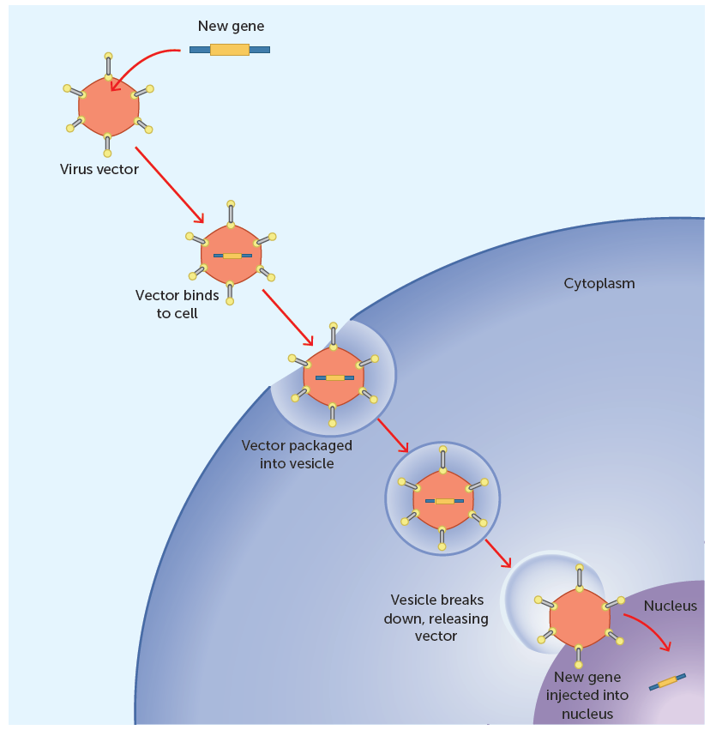
Gene Therapy
Aims to treat or cure disease by identifying faulty genes and inserting healthy ones.
Still in research phase.
Concept is that a vector (eg a virus)can be used to deliver the desired DNA into the cell, to be incorporated by the nucleus and produce desired protein.
Areas of possibility:
Replacing mutated gene with healthy copy*
Eg Huntington’s disease, Cystic Fibrosis, Type I Diabetes
Fixing or inactivating mutant genes*
Eg Huntington’s disease
Inserting a new gene that will fight the disease
Making the immune system recognise diseased cells.
Eg therapy for some cancers
*These ones could be used for Huntington’s Disease
Learning Aim: Describe how gene therapy works and why it may be useful in future to treat Huntington’s Disease

Slide 5
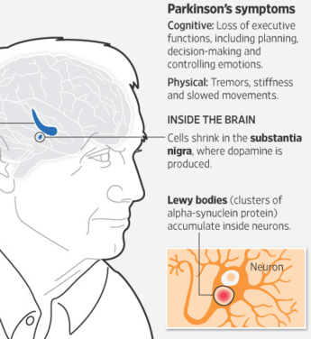
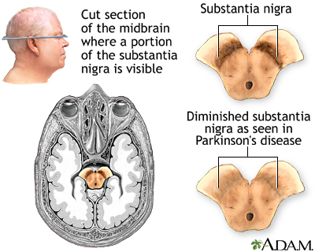
Parkinson’s Disease
Degenerative (progressive) neurological disease
Central NS tissues affected
Cell death in substantia nigra (in basal ganglia) decreases dopamine production causing symptoms
No identified cause of the cell death
Lewy bodies (protein) accumulates inside neurons
Symptoms: Impaired motor skills and speech
Usually diagnosed later in life (between 60 and 70 years old)
No cure, but can be managed.
Future cure may be cell replacement therapy
Learning Aim: Describe the disease progression and symptoms of Parkinson’s Disease

Slide 6
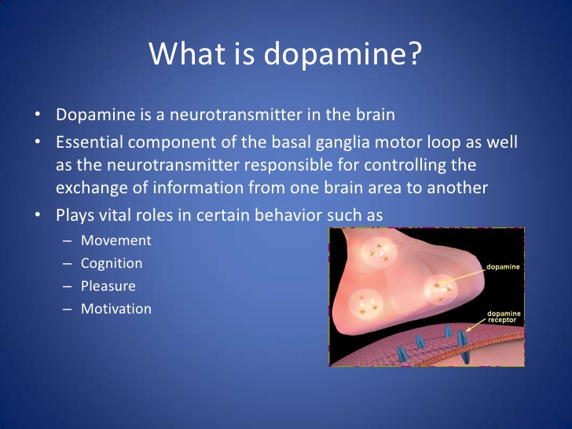
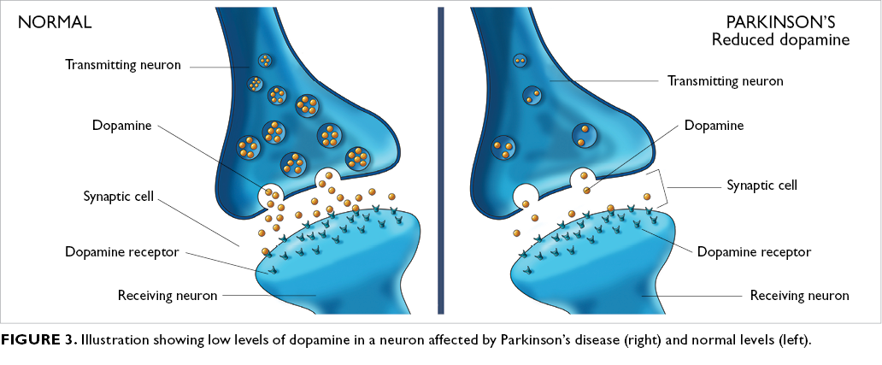

Slide 7
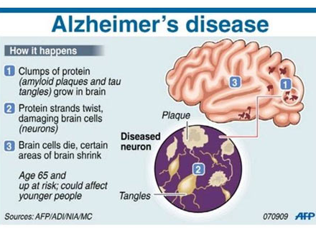
Alzheimer’s Disease
Progressive Degenerative disease of the brain
Usually diagnosed after the age of 65
No clear cause has been established
Disease progression:
Learning Aim: Describe the disease progression and symptoms of Alzheimer’s Disease

Slide 8
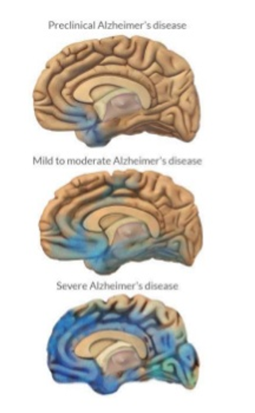
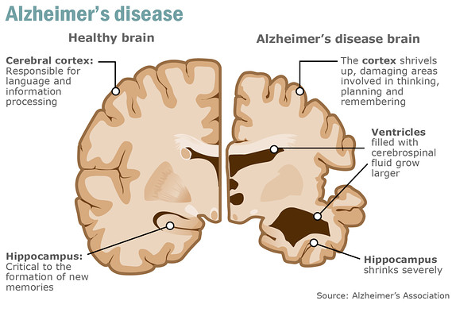
As the disease progresses…
Neurons lose their ability to function and communicate with each other, and eventually die.
As it progresses, neurofibrillary tangles spread throughout the brain (shown in blue). Plaques also spread throughout the brain.
By the final stage, damage is widespread and brain tissue has shrunk significantly.
Currently no cure – future cure could be cell replacement therapy
Learning Aim: Describe the disease progression and symptoms of Alzheimer’s Disease

Slide 9
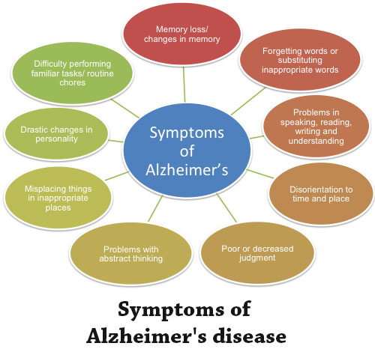
Learning Aim: Describe the disease progression and symptoms of Alzheimer’s Disease

Slide 10
Cell Replacement Therapy
Could be used in future for neurodegenerative disorders such as Alzheimer’s and Parkinson’s.
Replacement of dying neurons with healthy ones derived from stem cells
Can grow and differentiate to replace damaged tissue
Controversy surrounding use of human embryonic stem cells
Other sources of stem cells are being researched
Technique not yet refined – is a potential future treatment.
Learning Aim: Define cell replacement therapy and discuss how it could be useful in future to treat Parkinson’s and Alzheimer’s diseases

Slide 11
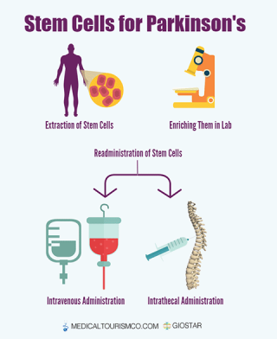
How Cell Replacement therapy might work once it is through the experimental stage:
Healthy stem cells are extracted – could be:
From the patient – pluripotent, multipotent
Embryonic - totipotent
Stem cells are enriched in the laboratory:
Programmed to differentiate into cell type needed
Eg dopamine producing neurons for Parkinsons
May also be genetically modified to “fix” faulty stem cells
Cultured to grow and divide so many are available.
Stem cells are administered to the patient
Grow new, healthy tissue to replace damaged cells
Can be administered IV or into spine for Parkinson’s
Learning Aim: Define cell replacement therapy and discuss how it could be useful in future to treat Parkinson’s and Alzheimer’s diseases

